Slide 1




From Visual Salience to Bodily Signal A Movement Science Approach to Gesture, Discourse and Prominence Šárka Kadavá ProDiGe workshop, Cologne, December 2025

Slide 2

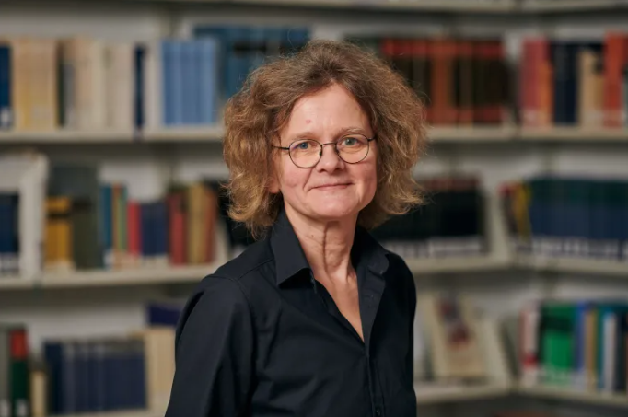


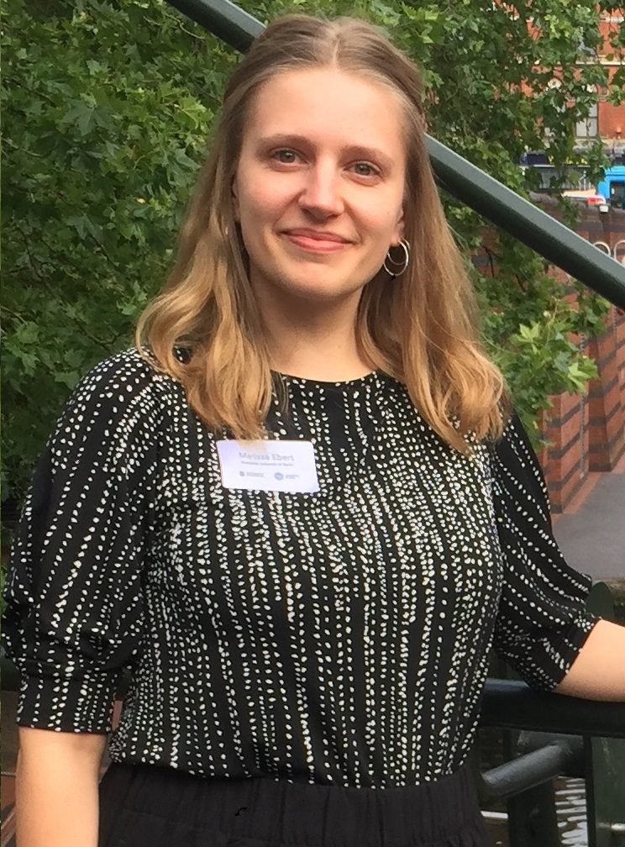




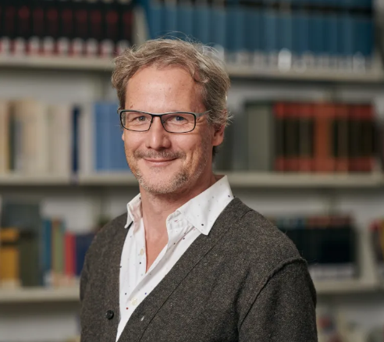

On the FLExibility and Stability of gesture-speecH coordination (FLESH)
Aleksandra Ćwiek
Susanne Fuchs
Šárka Kadavá
Wim Pouw
Melissa Ebert
Justin Snelders
Jet Lambers
Hamza Nalbantoğlu
Gillian Rosenberg
Markus Steinbach
Judith Holler

Slide 3
Today’s agenda
i. Theoretical foundation
Dimensions of movement
(Rather quick) intro to motion tracking
Hands-on tutorial
Notes:
And I want to dedicate some time to each of the points

Slide 4
What is gesture?
„actions that have the features of manifest deliberate expressiveness“ (Kendon 2004)
„utterance dedicated visible bodily action“ (Kendon 2016)
„motion that embodies a meaning relatable to the accompanying speech“ (McNeill, Enc)
„communicative tools that can enhance or alter the recipient‘s understanding of spoken utterances (de Ruiter 2003)
„a movement of the hands, arms, or head, etc. to express an idea or feeling“ (CambDic)
“communicative movements of the hands and arms, which, similar to language are used to express the thoughts, feelings, and intentions of a speaker” (Müller 1998)
Notes:
utterance=“to refer to any ensemble of action that counts for others as an attempt by the actor to ‘give’ information of some sort.”

Slide 5

Definition shapes annotation
Gesture as meaningful ← what is the meaning?
iconic, metaphoric, deictic, pragmatic, …
Gesture relates to speech ← temporal dimension synchrony with prosodic peaks, lexical affiliates, …
Gesture is (somewhat) movement ← articulatory phases preparation, stroke (and apex), hold, retraction, …
Notes:
utterance=“to refer to any ensemble of action that counts for others as an attempt by the actor to ‘give’ information of some sort.”

Slide 6
Problem I: theory
Meaning emerges from movement…
Iconicity is expressed through shape, velocity, trajectory, direction (Spruijt XX)
Beats derive their function from rhythmic, dynamic movement qualities
Emphasis emerges from acceleration, amplitude (and effort)
Trajectory and endpoint position of pointing gesture (i.e., the precision) matter for reference
Movement is continuous
Gesture phases simplify; hide variations, and cannot represent the dynamic nature of gesture
Timing is only one layer of multimodal coordination
xxx
Notes:
And I want to dedicate some time to each of the points

Slide 7
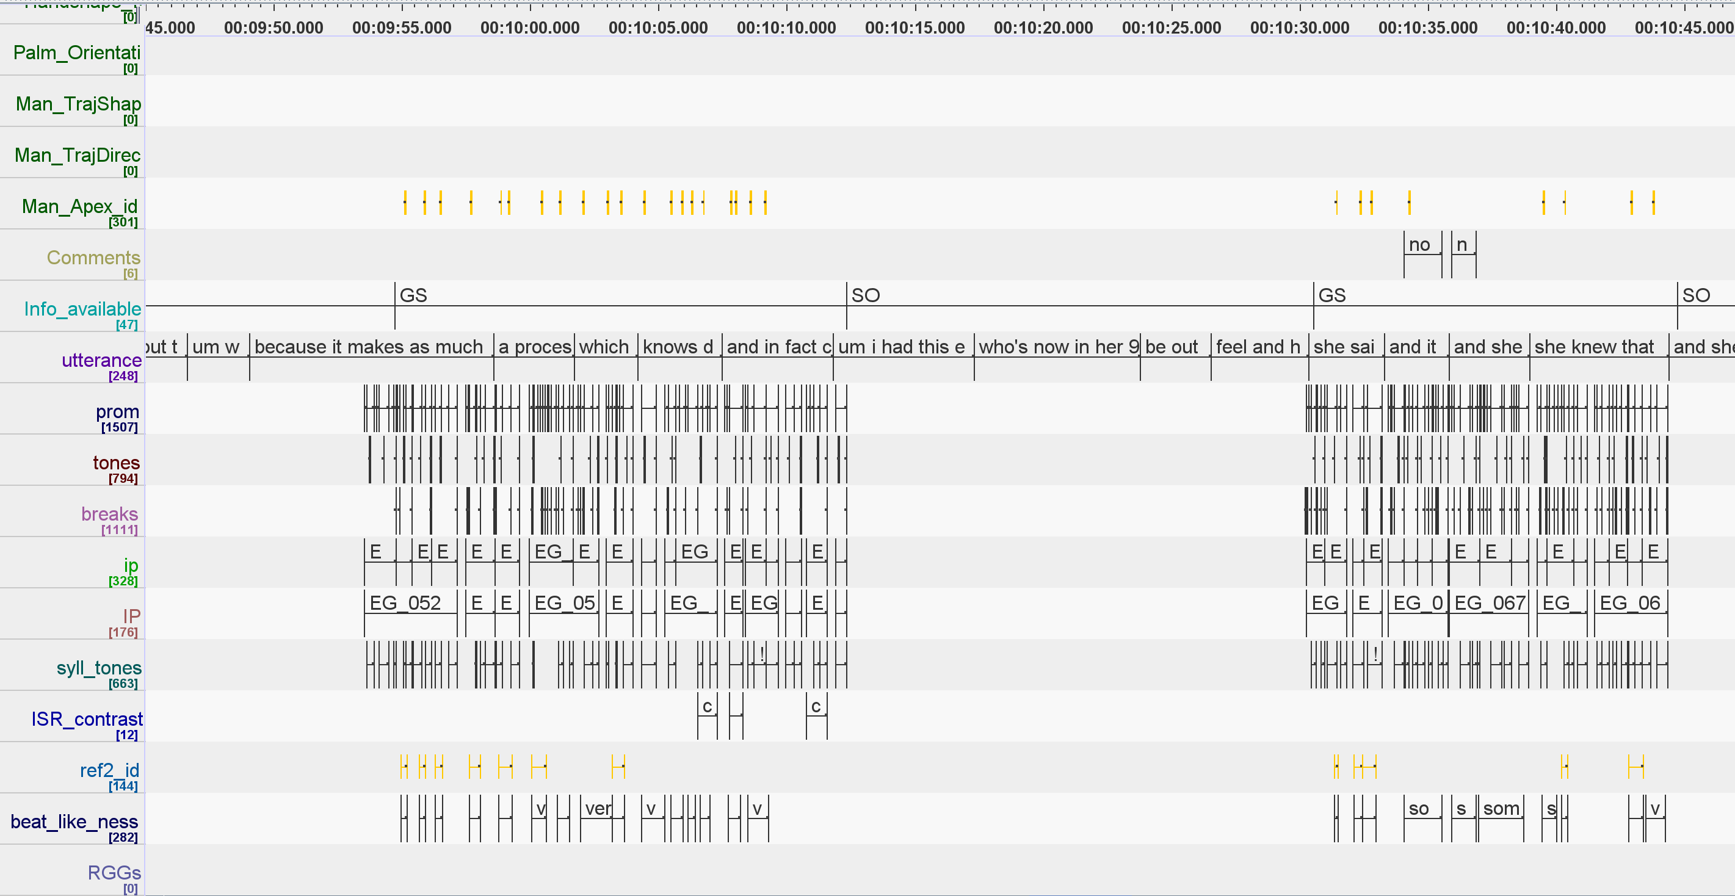
Problem II: practice
Resources (esp. time)
Notes:
And I want to dedicate some time to each of the points

Slide 8
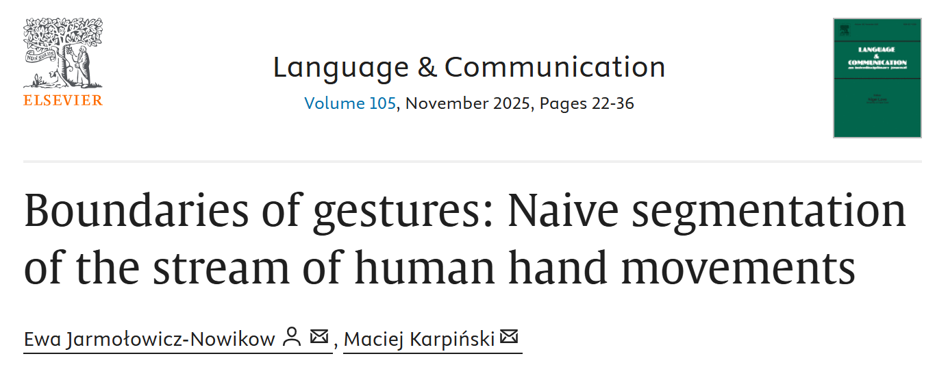
Problem II: practice
„Reliability“
„Researchers frequently use video annotation software to facilitate this process, leveraging features like multiple playback speeds, slow-motion, and reverse playback. However, many spatial and visual aspects of annotating videos on a computer screen differ markedly from real-life communicative contexts. These differences include the size and visibility of the observed individual on the screen, the absolute distance from the person, the absence of a fully three-dimensional perspective, and the potential for either more restricted or more expansive access to the communicative situation. Such disparities may influence the annotator’s focus, leading to prioritizing different phenomena or aspects of behavior during the annotation process.“
Notes:
And I want to dedicate some time to each of the points

Slide 9
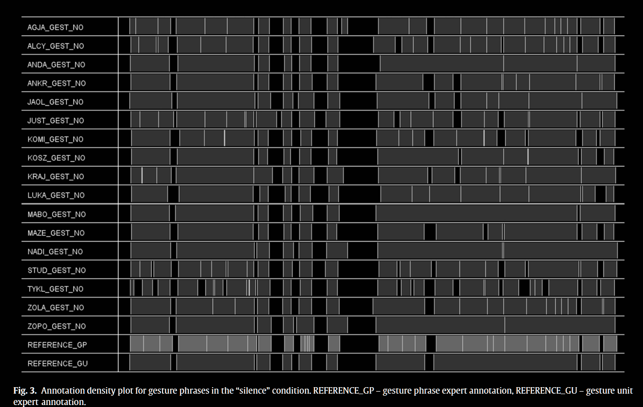
What is actually gesture in a stream of behavior?
Notes:
Gesture unit: span
s of time when speaker use their hands to communicate (from rest to rest). There needs to be 1. movement and 2. intention

Slide 10
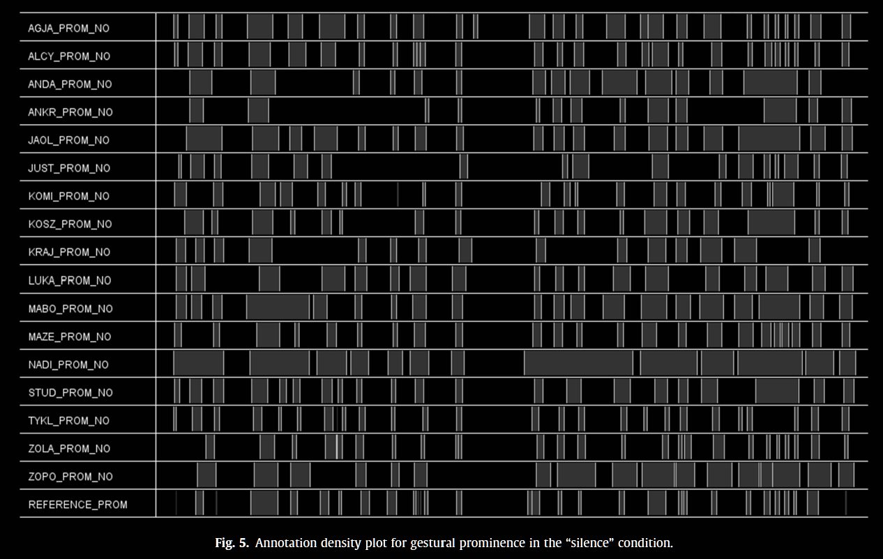
What is gestural prominence?
Notes:
And I want to dedicate some time to each of the points

Slide 11
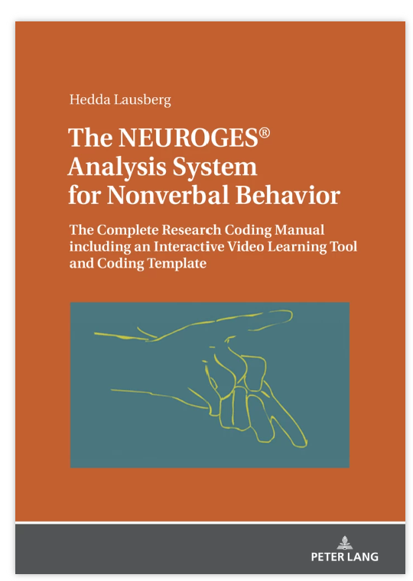
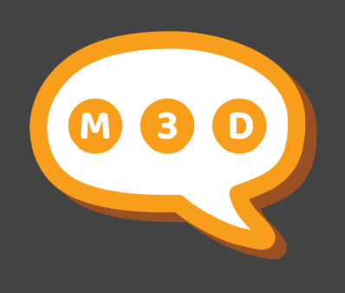
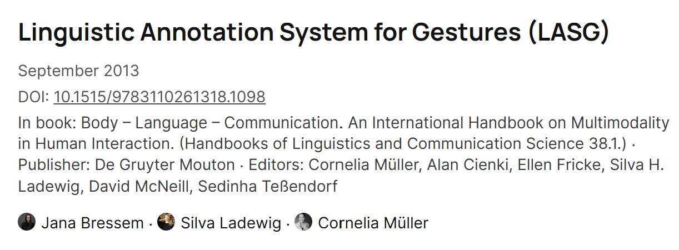
Working with manual annotation...
😊
Flexible
Powerful, esp. for quali-analysis
Somewhat consensus around annotation schemes
😕
Laborious
Can be quite slow and buggy
Different types of annotation schemes
Perception-dependent
Notes:
Perception-dependent
What matters is what we see (or what we learned to see) as salient
IA reliability reflects perceptual agreement (or good adherence to learned scheme), not movement per se
Biased toward large rapid, salient gestures
Temporal imprecision - perceptual boundaries are fuzzy (critical for gesture-speech alignment)
Stroke identification is interpretation, not measurement

Slide 12

For prominence research, which matters more – the perceptual stroke or the acceleration peak that aligns with pitch accents?
Notes:
Does movement matter more than perception? It depends. If prominence is about listener perception, maybe perceptual salience is what matters. But if prominence is about speaker effort and coordination, then biomechanical properties matter. Likely both contribute - which is why multimodal models need both perspectives.

Slide 13
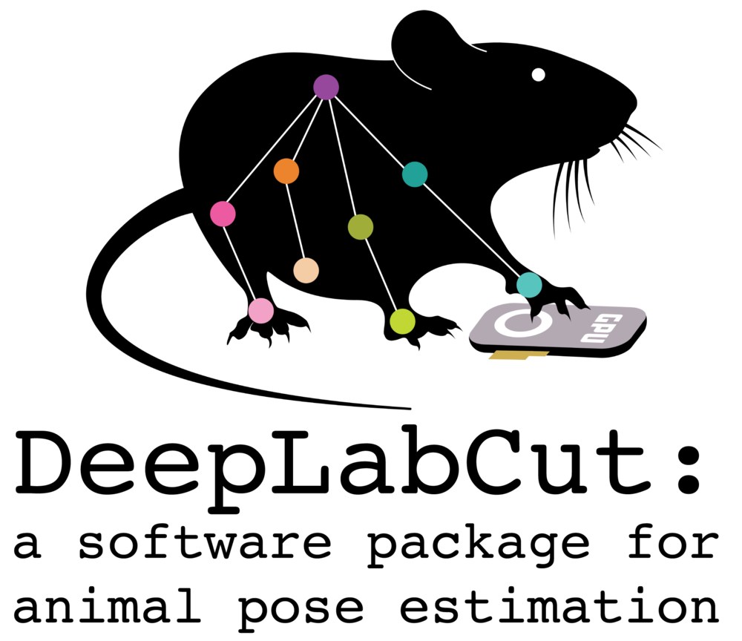
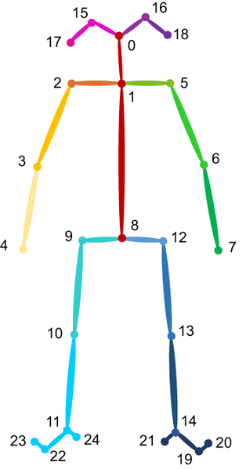


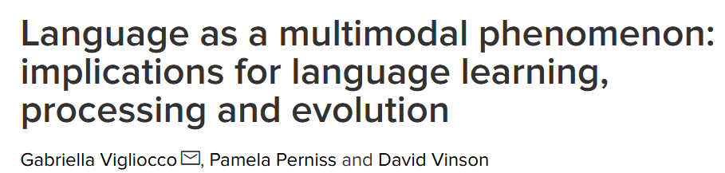

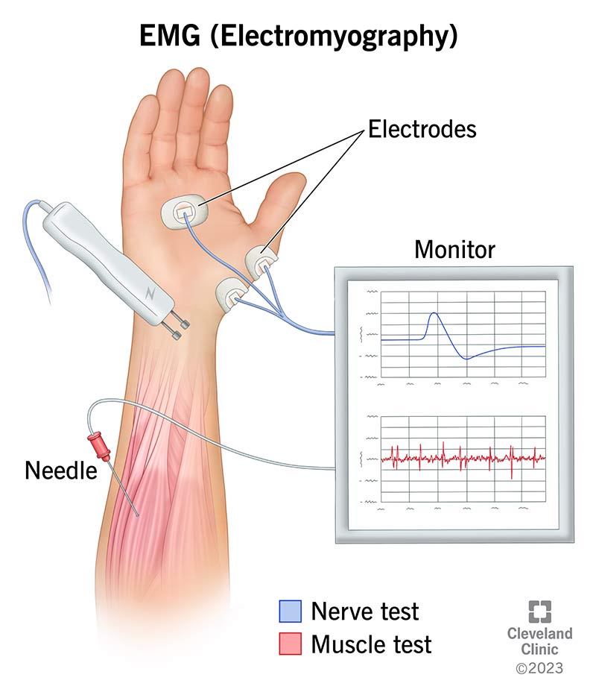
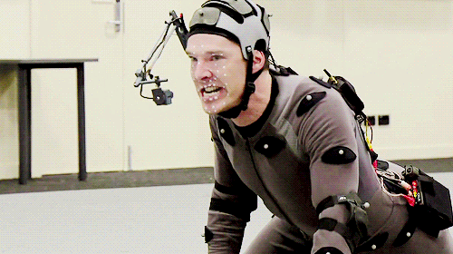
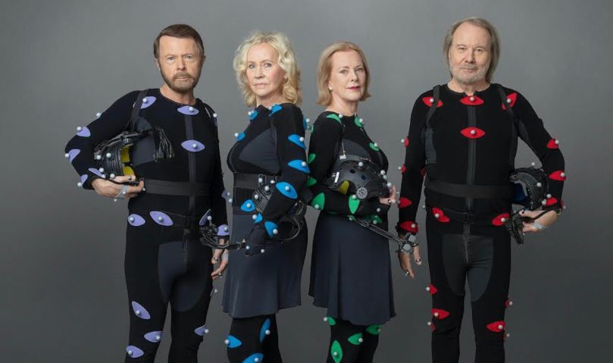
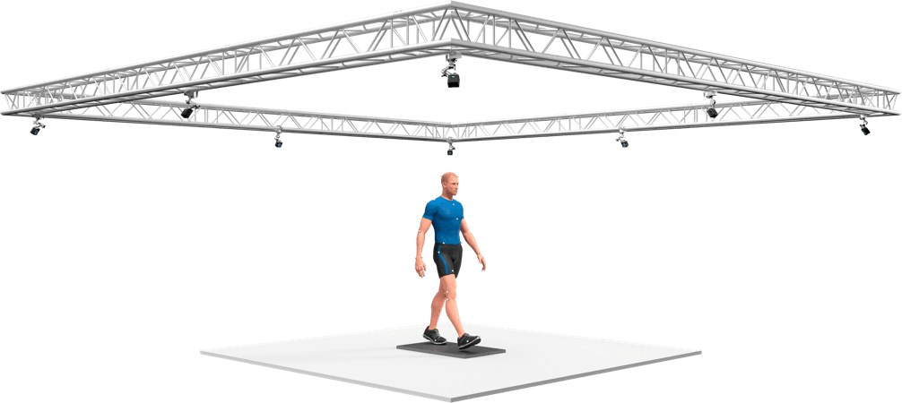
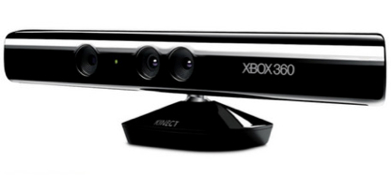
2000
2014
Notes:
30 years ago, if you wanted to study this - you had your eyes and perhaps notebook to make notes
20 years ago, you finally had ELAN (release 2000), so you have a sophisticated interface that allows you to code for many things, but what you end up in the end is mostly counts and durations
Also notice, that only last 10 years multimodality is becoming mainstream
But of course gestures are emerging as a topic to study since 80s (Bates, McNeill, Kendon)
There is parallel – biomechanical, sport science – stream of people researching movement as such – so occasionally there is someone who take these methods into linguistic domain
Qualisys – 90s, Optitrack ca 2005
2006 – paper in Journal of NeuroEngineering and Rehabilitation that there is need for markerless motion capture But recently, the developments really accelerated
ADD EMA FROM COLOGNE

Slide 14
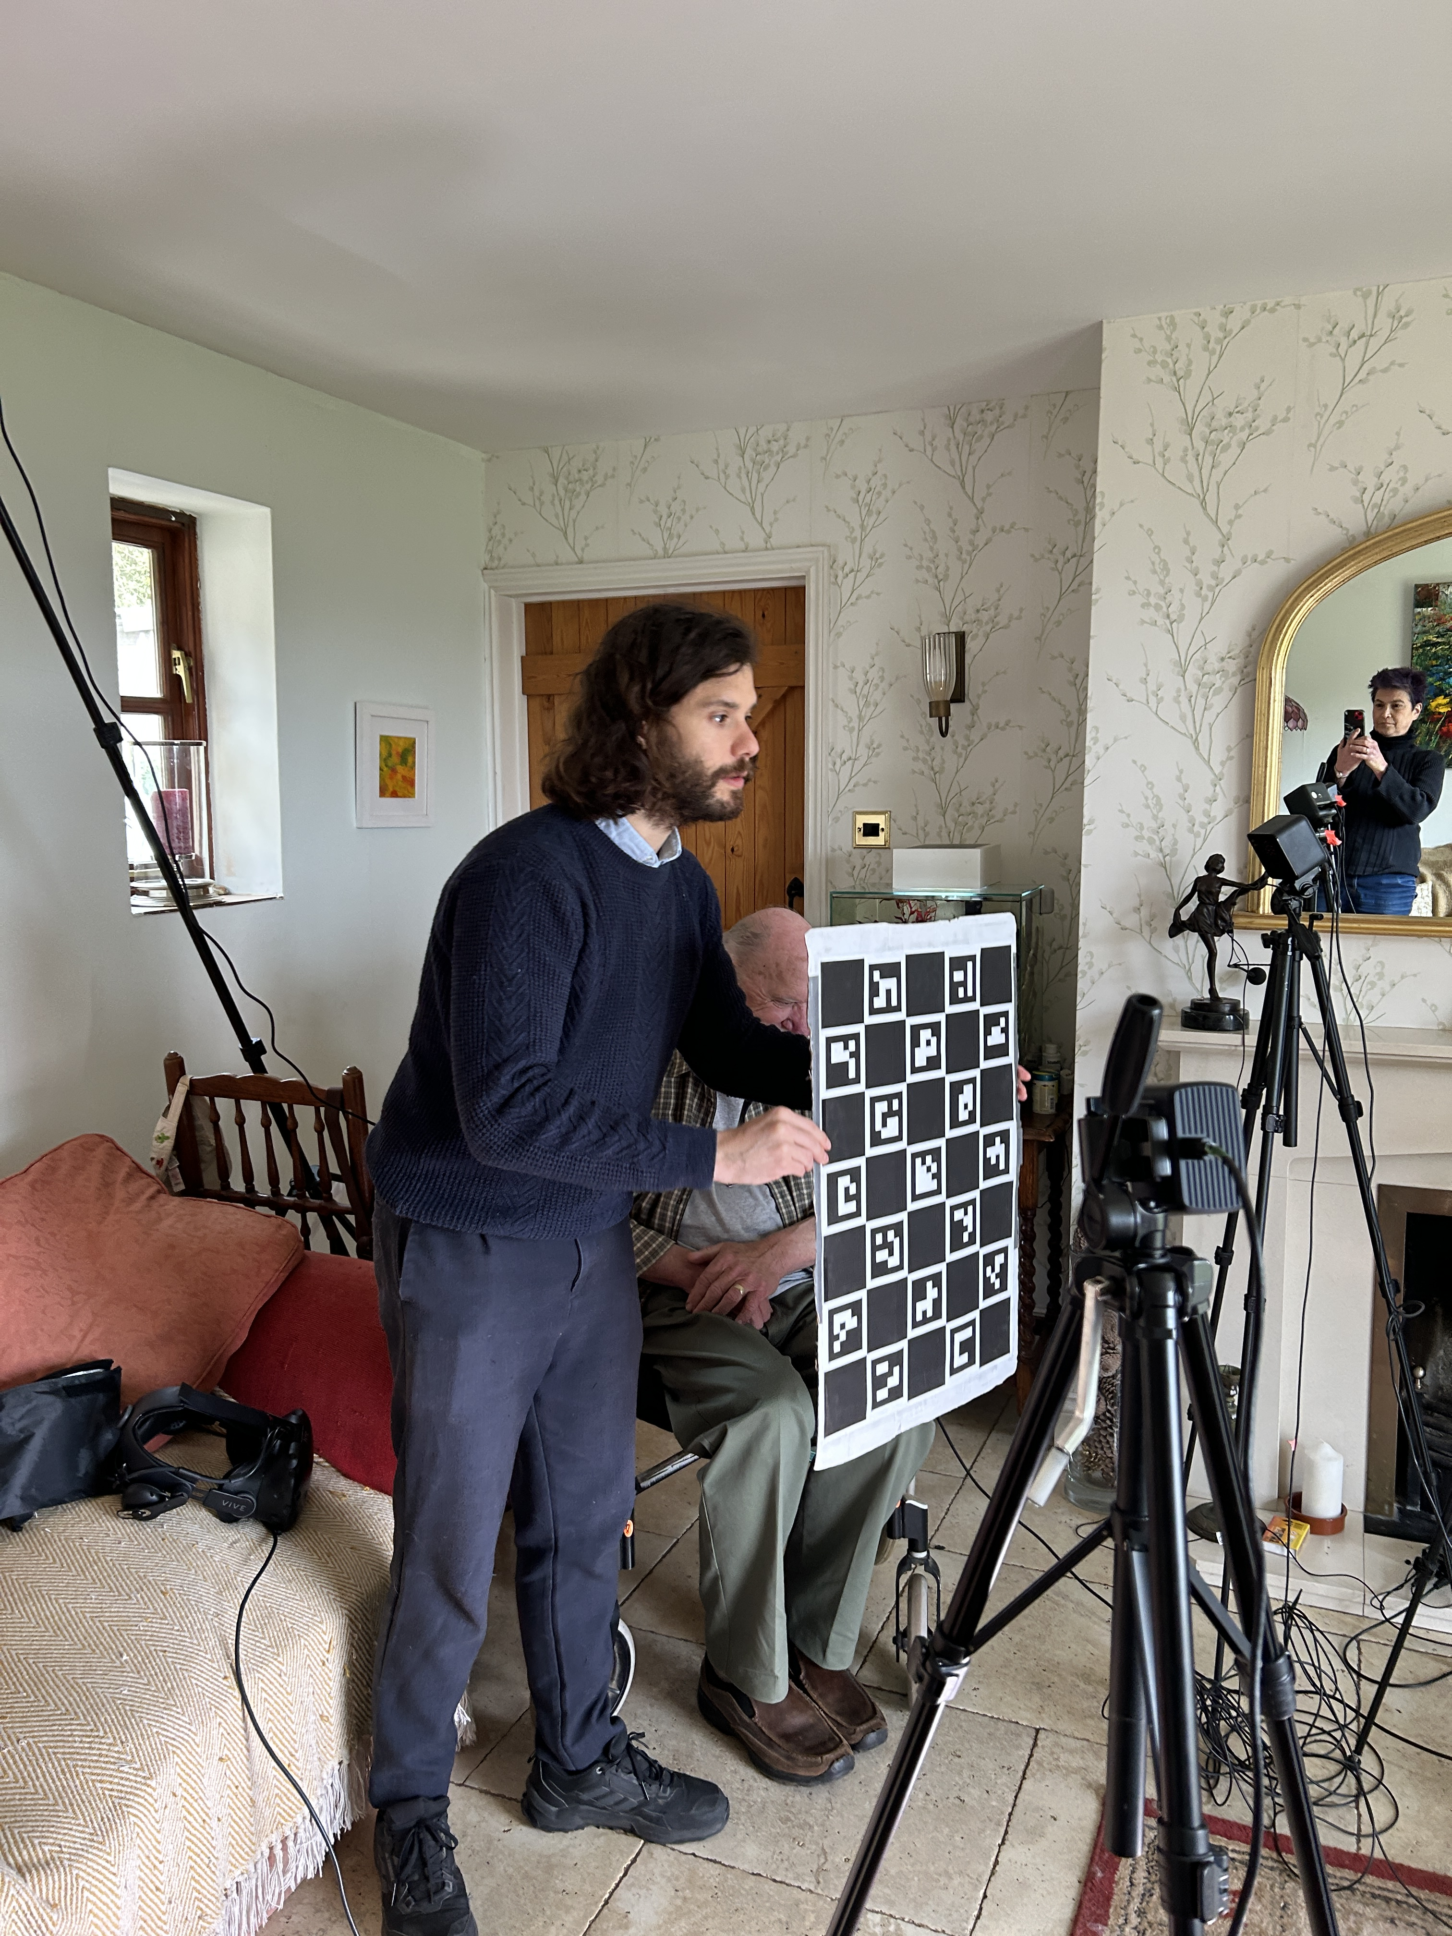
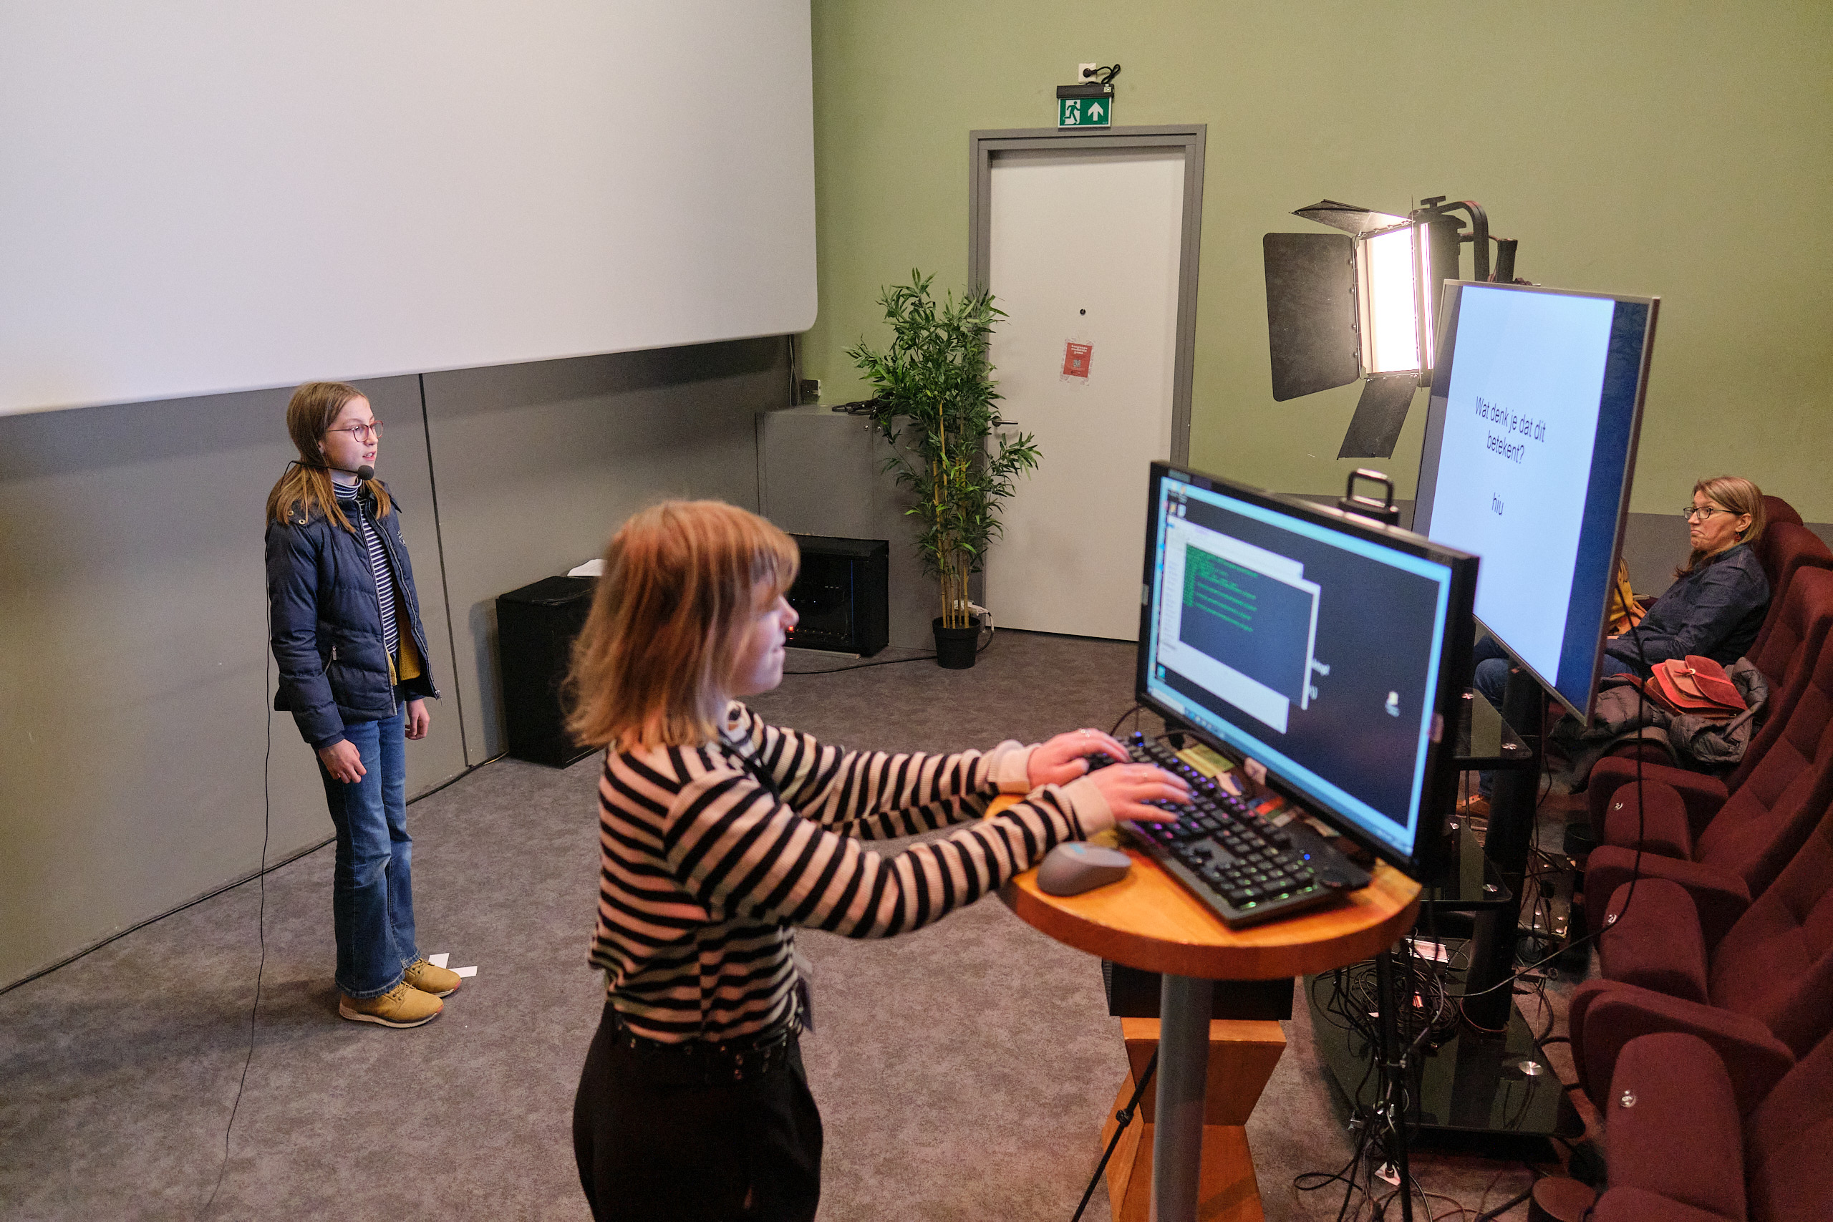
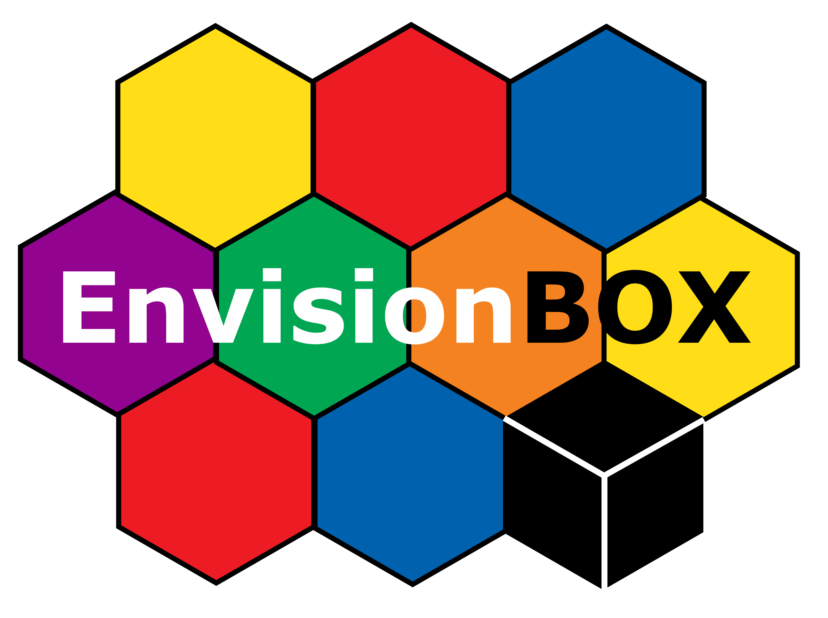
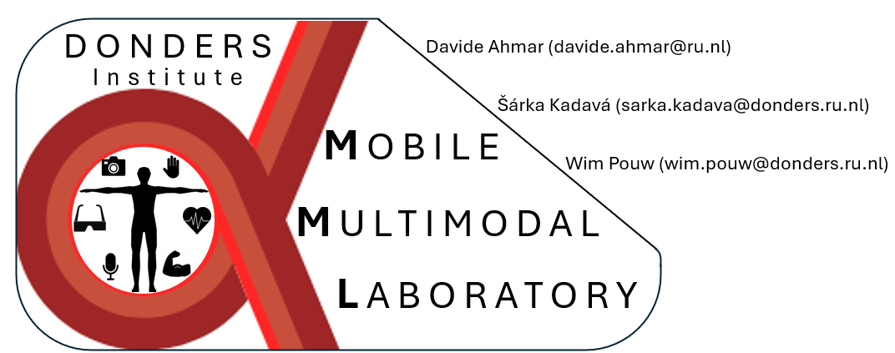
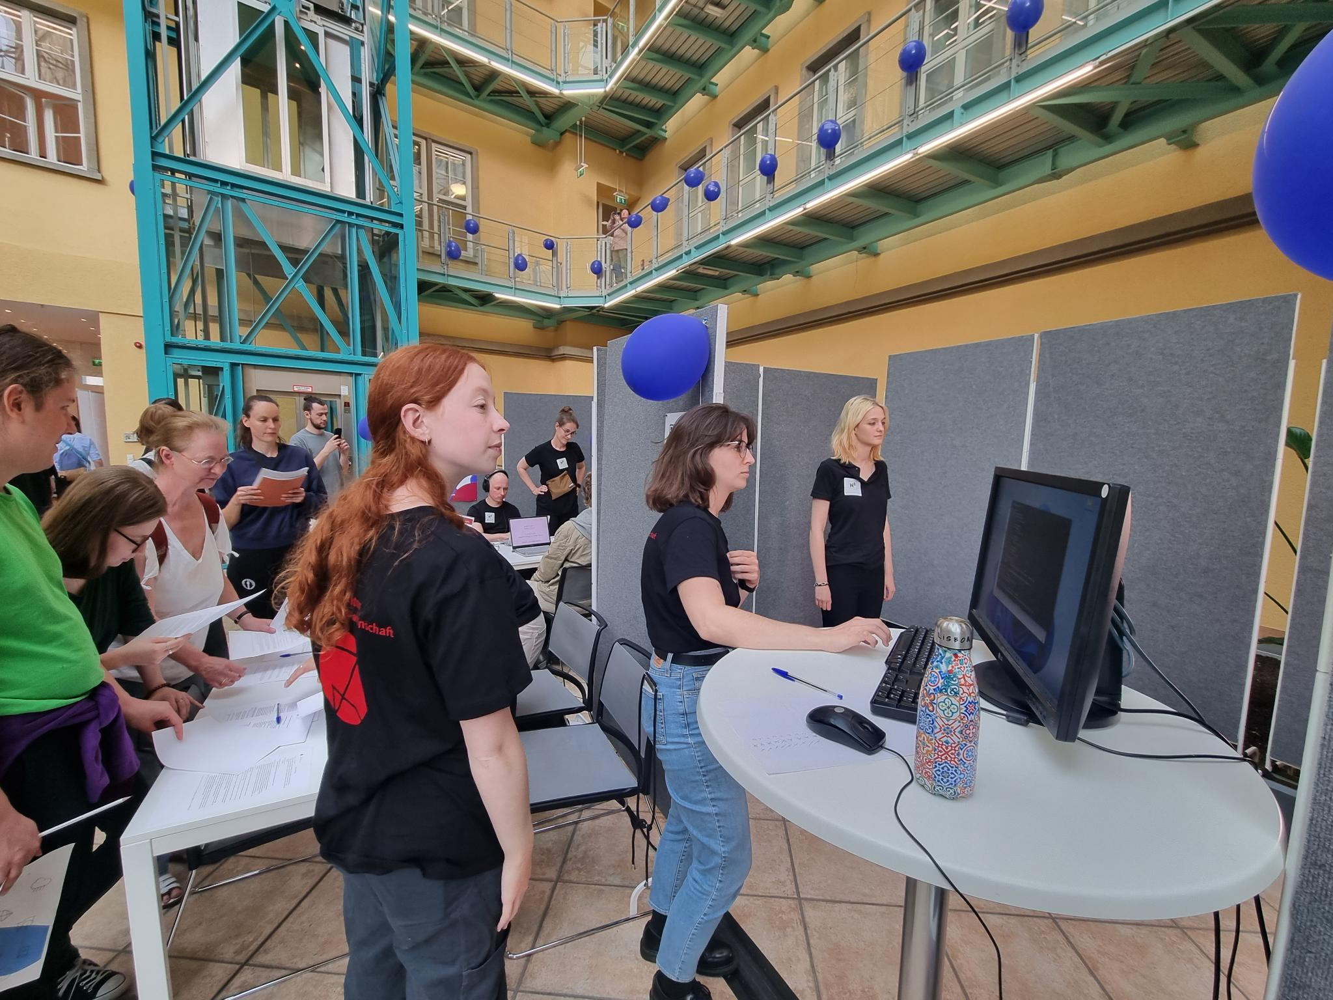
What is so great about it?
1) it allows to ask new research questions
2) it democratizes science
3) it frees the hands
4) it crosses the departments & fields
Notes:
So you don’t need licence
Therefore in theory, anyone can reproduce (and replicate) your pipeline (think of Matlab code)
It also means people constantly work on new workflows, or are improving the old one
It’s cheap. Essentially you need 3 good enough cameras. Device-based motion tracking of the best quality around 100 – 200 K €
Since all is done in post-processing, you can essentially take your setup (cameras) anywhere
6) It can be useful for many people working with multimodal data – even the already recorded ones

Slide 15

New possibilities for gesture!
Automatic detection
Quantification
Precise temporal alignment
Capturing variation
Notes:
A02: Quantify individual gesture 'styles' (velocity distributions, smoothness, amplitude)
C03: Compare kinematic patterns in L1 vs. L2
C09: Measure gesture effort/cost for Bayesian communication models
A01: Test temporal relations between speech and gesture prominence
A07: Does hand acceleration lead, lag, or synchronize with pitch accents?

Slide 16
What does it mean when I say gesture is movement?
It is material/physical and continuous/dynamic
It has measurable properties
Notes:
And I want to dedicate some time to each of the points

Slide 17
Dimensions of movement
Kinematics describes motion of points and bodies
Where? Position
How far? Displacement
How fast? Velocity/speed
How suddenly? Acceleration
How smoothly? Jerk
Notes:
And I want to dedicate some time to each of the points

Slide 18
Dimensions of movement
II. Kinetics/dynamics describes the cause of motion
How effortful? Forces, joint torques
How coordinated?
Notes:
And I want to dedicate some time to each of the points

Slide 19
Dimensions of movement
III. Others
Volume
Hand shape configuration
Coordination
Rhythmicity
Notes:
And I want to dedicate some time to each of the points

Slide 20
COMPARISON
Notes:
And I want to dedicate some time to each of the points

Slide 21
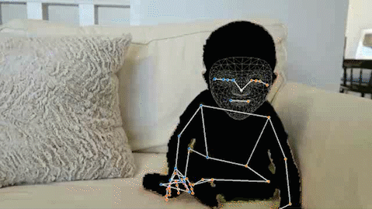
(Rather quick) intro to motion tracking
Very high precision (ca. 0.5 mm)
Lab-based
Proprietary (→ expensive)
Lower precision (1-2.5 cm)
No markers needed
Open-source
Notes:
And I want to dedicate some time to each of the points

Slide 22
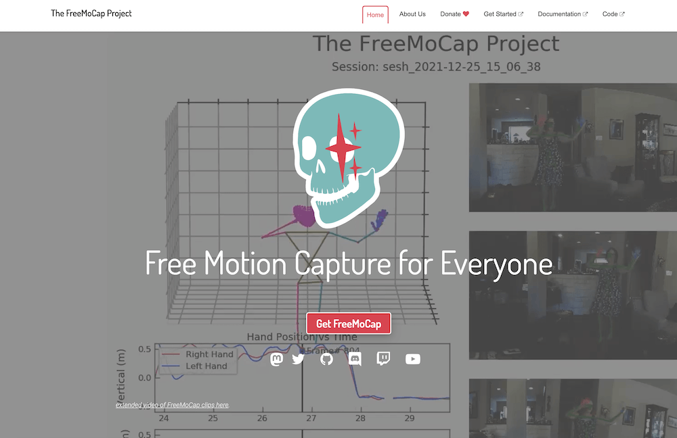
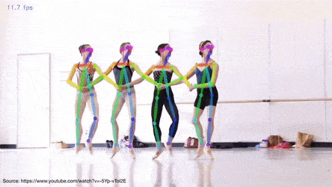
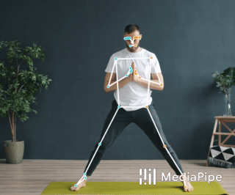
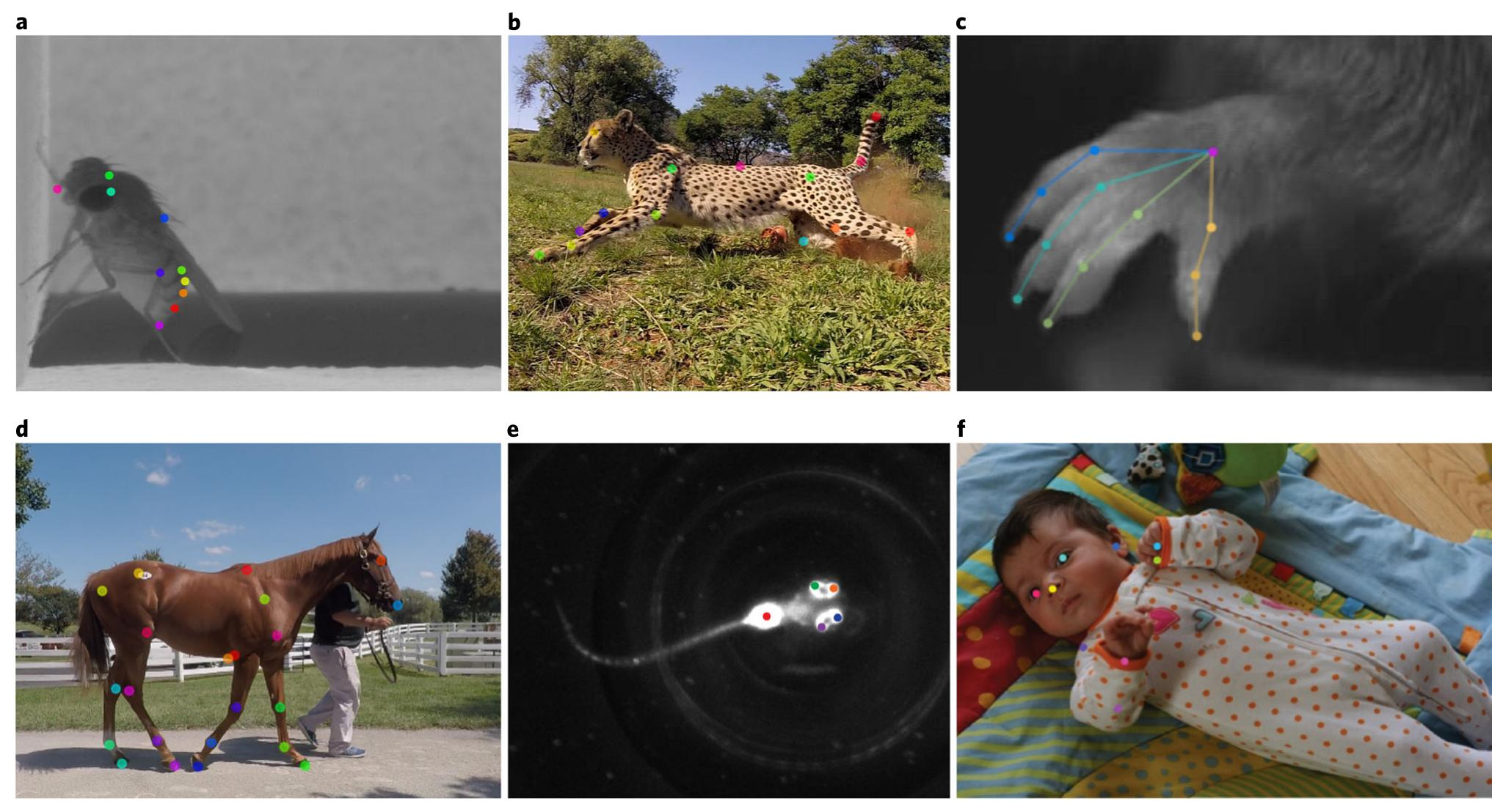
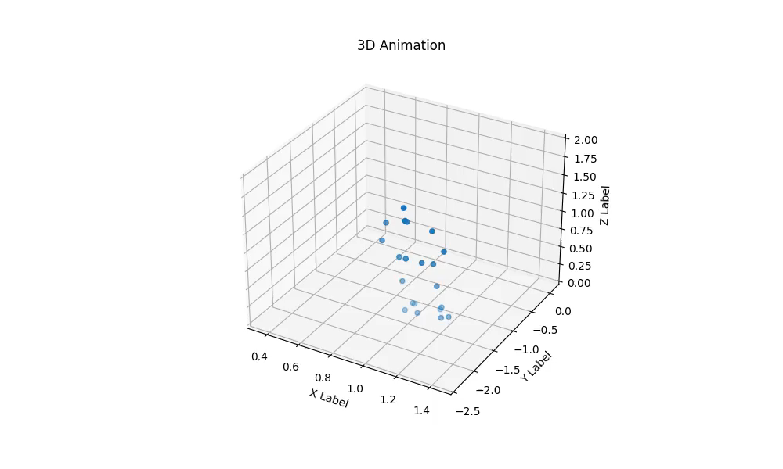
Most common marker-less tracking
FreeMoCap
OpenPose
MediaPipe
Pose2sim
DeepLabCut
Notes:
And I want to dedicate some time to each of the points

Slide 23
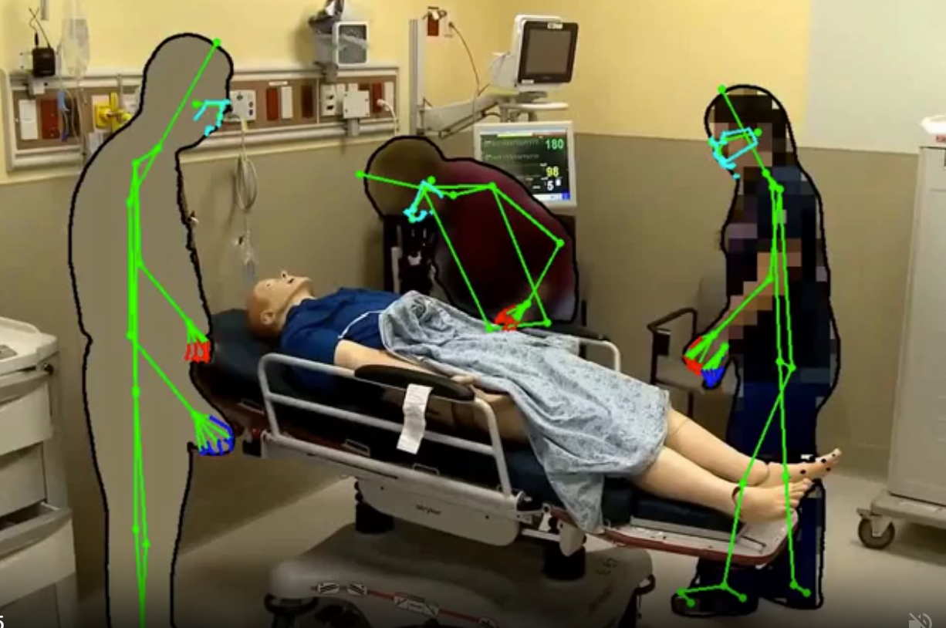

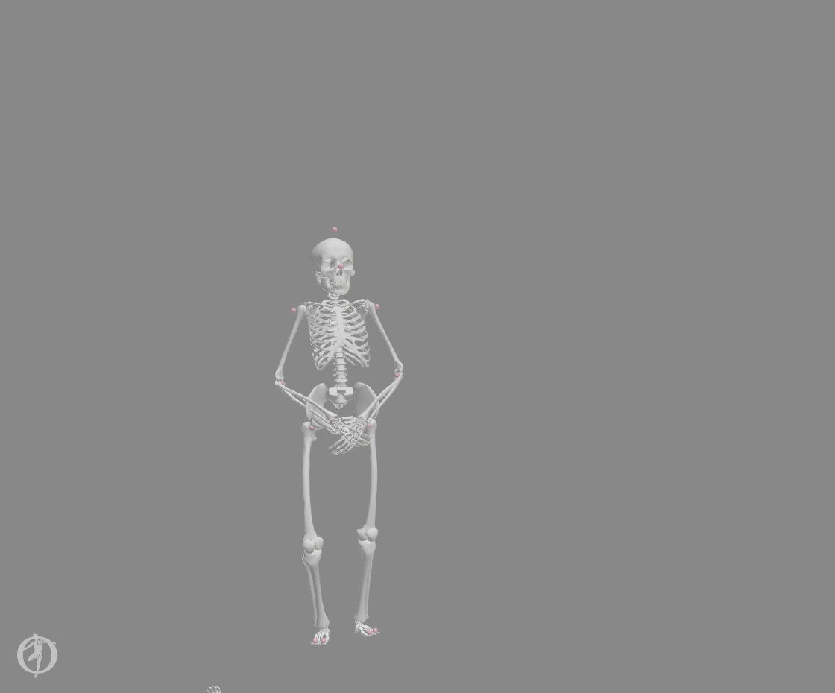
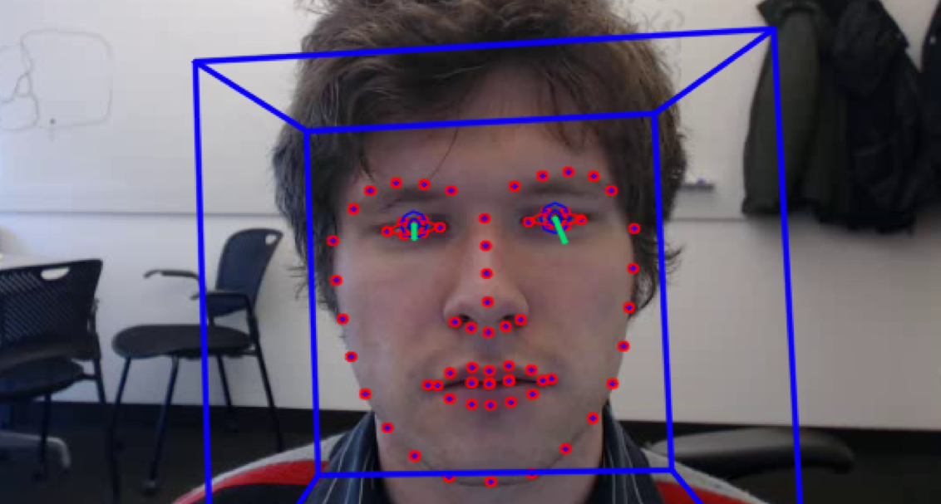
Add-ons
OpenFace
MaskAnyone
Notes:
And I want to dedicate some time to each of the points

Slide 24
Considerations
Notes:
And I want to dedicate some time to each of the points

Slide 26
Let’s get to work
👩‍💻

Slide 27
HANDS-ON
Notes:
And I want to dedicate some time to each of the points

Slide 28

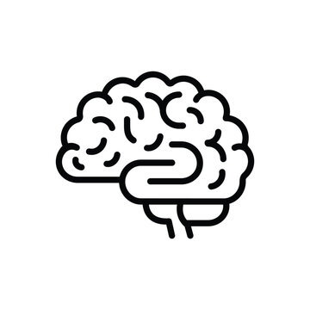
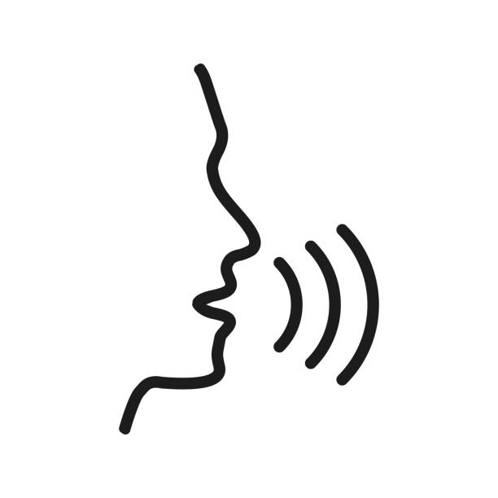
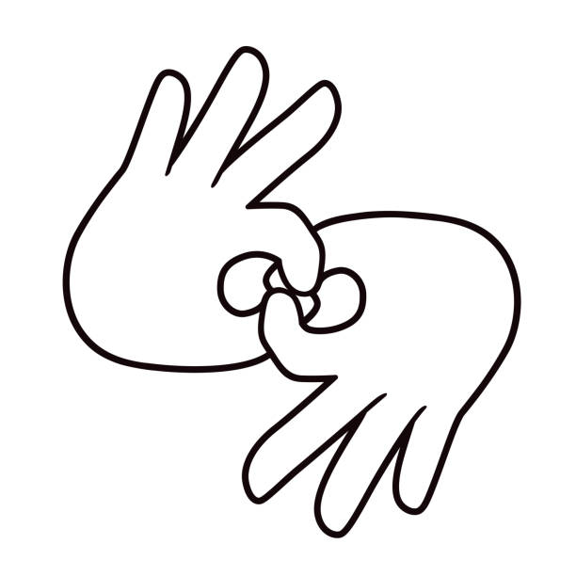

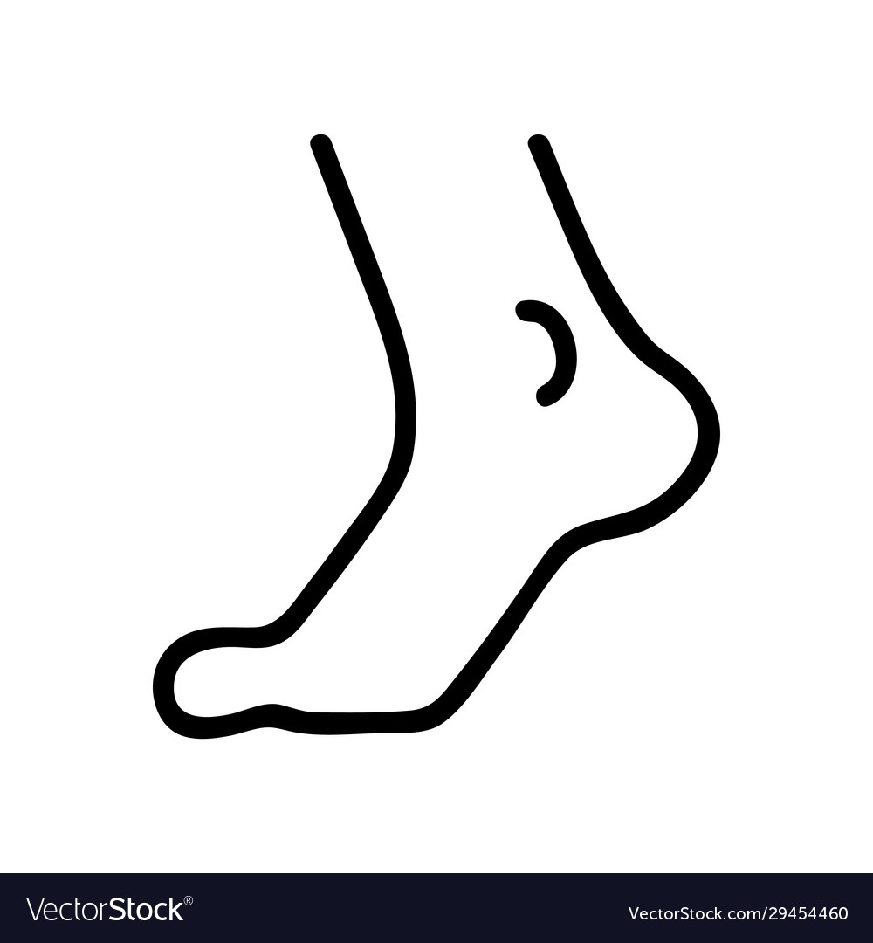
Final remarks
Fuchs & Rochet-Capellan 2014
~ gesture does not operate on an abstract level, it‘s profoundly physical and entangled with whole-body physiology
Pouw et al. 2020
Serré et al. 2022
Pouw & Fuchs 2023
Weston et al. 2024
Offrede et al. 2024
Sundberg et al. 1991
Yardley et al. 1999
Lagier et al. 2010
Notes:
But there are important PHYSICAL/MATERIAL things to appreciate on what does it mean to enagage in language/communication
Language is material – as speech, sign, etc.
Language emerges and is affected by breathing
Some muscles are used in both moving and breathing, meaning that our body affects how we speak (think of speaking while running)
And that also means engaging in language has an affect on our posture – e.g., more vocal effort compensated by postural sway
Therefore engaging in language is engaging in movement -> to interact is to move

Slide 29
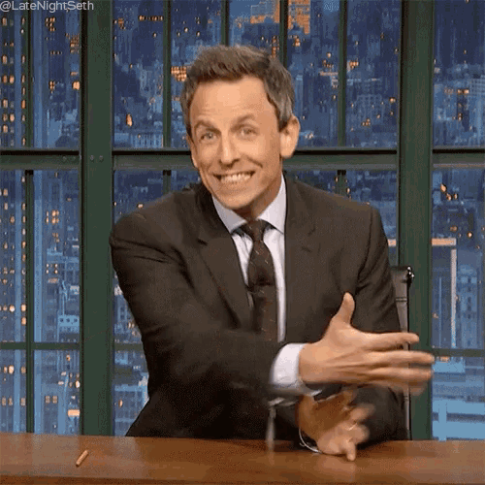
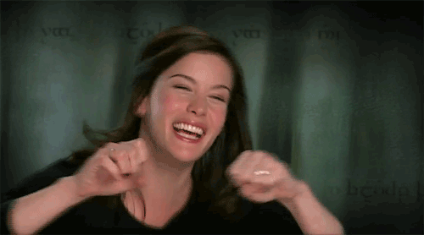
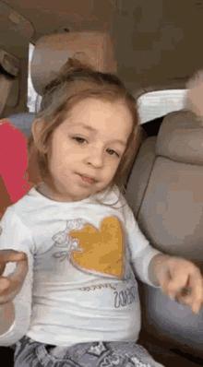

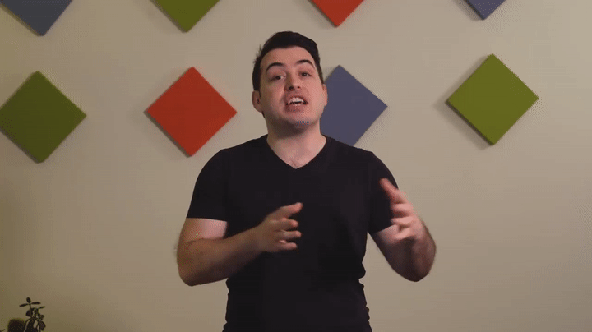
Final remarks
~ don‘t forget about other parts of body involved in meaning-making
Notes:
And I want to dedicate some time to each of the points

Slide 30
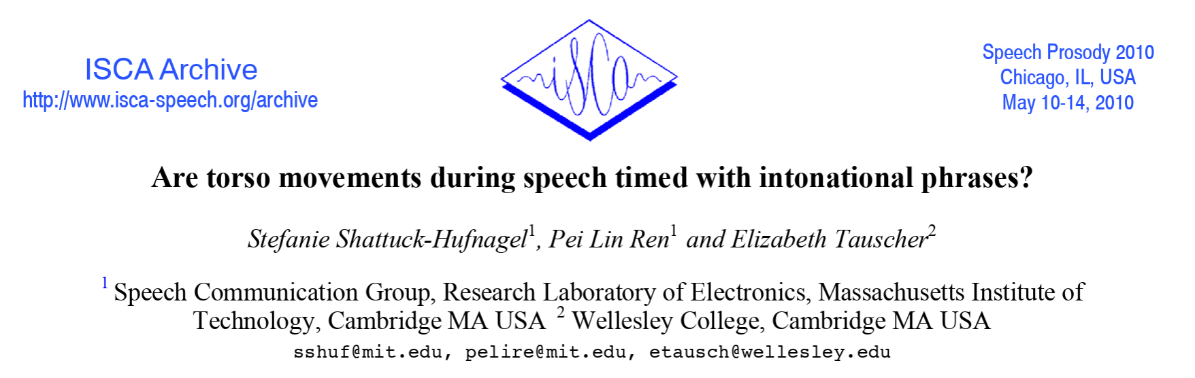
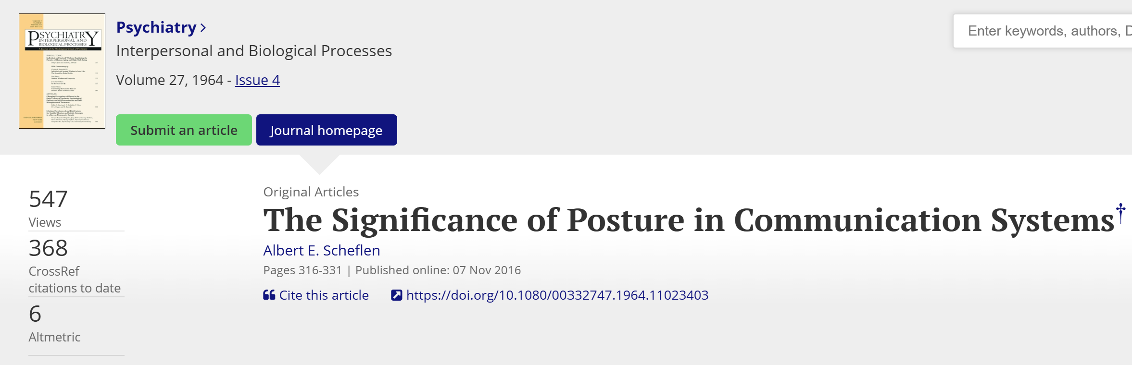

Slide 31
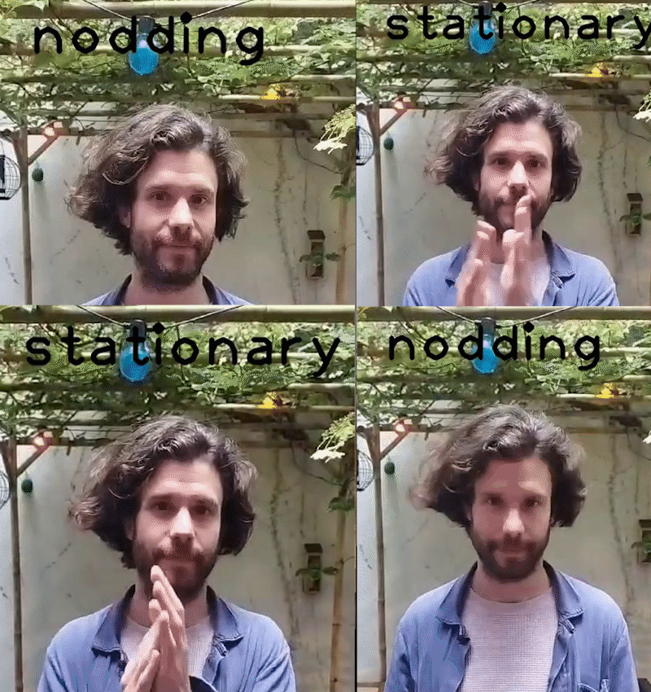
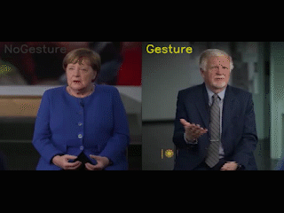
Final remarks
~ motion capture does not have to be the endpoint
Notes:
And I want to dedicate some time to each of the points

Slide 32
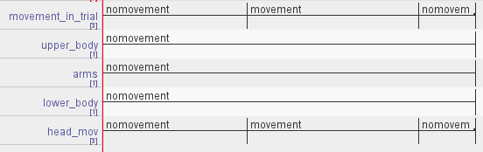
What if all the time spent in [fill in a name of an annotation software that you really hate] in the past can contribute to less time spent in it in the future?
Notes:
Actually, all the time could be now productively used – all annotations could be repurposed – but unfortunately that Is not what people share that much
Remember though that here it reproduces our biases

Slide 33
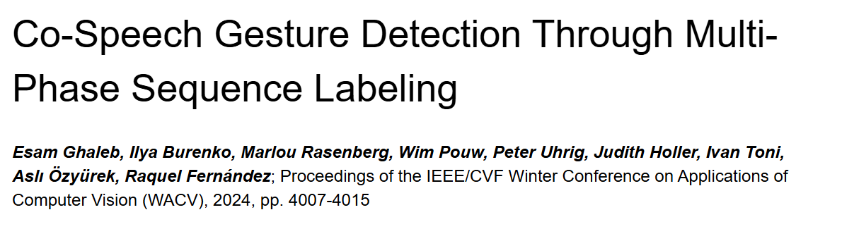
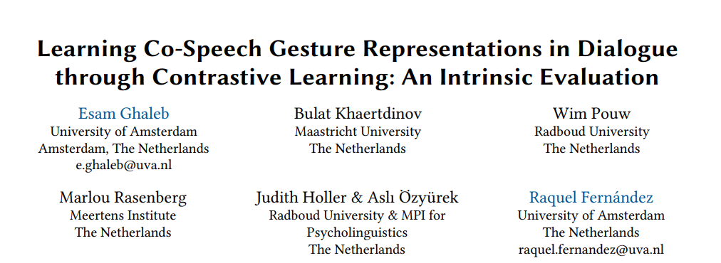
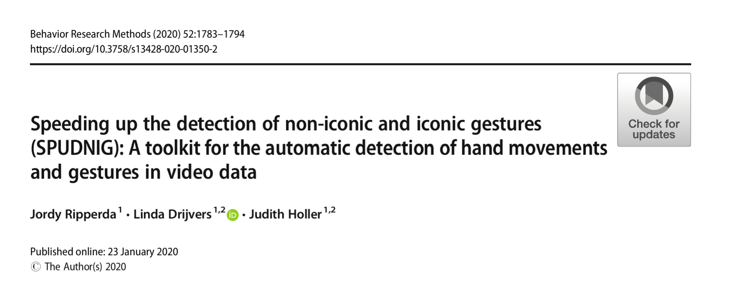
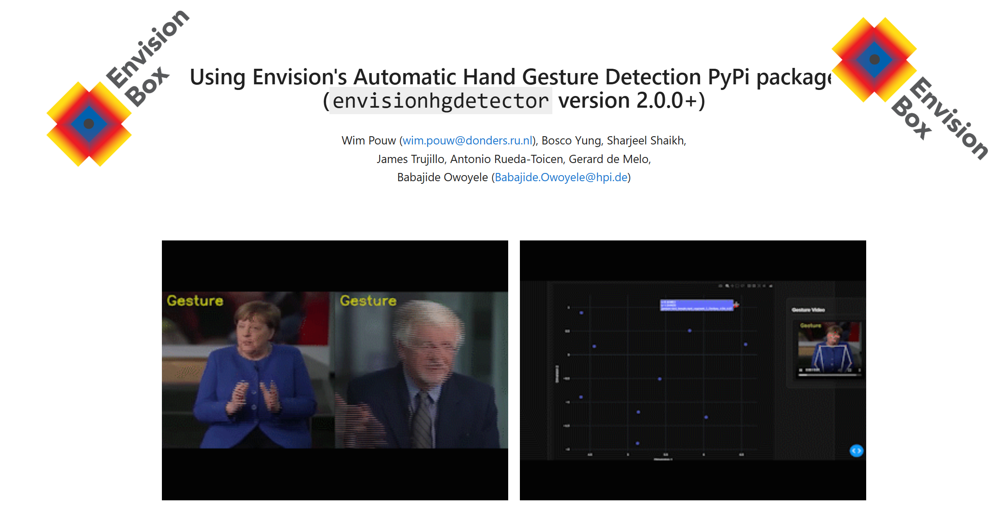
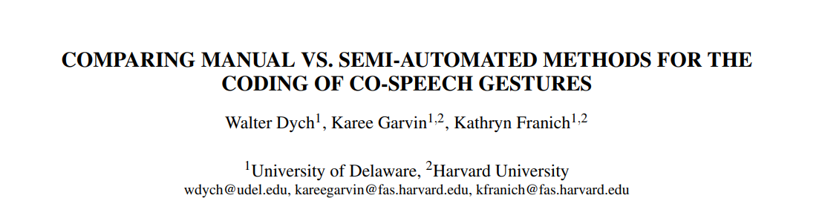
Notes:
Ultimately, this will slowly lead to automatic recognition algorithms etc

Slide 34
Final remarks
~ motion capture is a great accelerator of our field, but it does not do miracles
… there is some accuracy trade-off
… it requires some thinking about the ‚infrastructure‘
… it requires lots of processing steps (and thus, too, time)
… it requires constant sanity checks (!!!)
… sometimes coding is as annoying as ELAN
… data are just data without theory

Slide 35
Final remarks
~

Slide 36
Thank you for your effort! kadava@leibniz-zas.de
Sketches were retrieved from sketchyideas.co, people illustrations from openpeeps.com

